Slide 1

DEPARTMENT OF CSE (ARTIFICIAL INTELLIGENCE AND MACHINE LEARNING) ACADEMIC YEAR 2025 - 2026 SEMESTER III ARTIFICIAL INTELLIGENCE LABORATORY MINI PROJECT REVIEW <A Knowledge based AI simulation of Wumpus World using Python and Tkinter>
REGISTER NUMBER | 2117240030016
NAME | BARATH S
YEAR | II
SECTION | A
FACULTY IN-CHARGE | Mrs. M. Divya

Slide 2
PROBLEM STATEMENT
Overview: Artificial Intelligence (AI) enables machines to act intelligently by applying reasoning, search, and decision-making techniques. The Wumpus World is a classic AI problem that tests an agent’s ability to operate in an uncertain environment using logical inference. This project applies these AI principles to build a knowledge-based Wumpus World simulation using Python and Tkinter, where an intelligent agent perceives its environment, updates its knowledge, and makes logical decisions to find the gold and exit safely.
Problem Statement: To develop an intelligent knowledge-based AI agent that can perceive, reason, and act logically within the Wumpus World environment using knowledge representation and inference rules to navigate safely, avoid hazards, and achieve its goal efficiently.
Expected Result: A Python-based Wumpus World simulation where the AI agent intelligently explores the environment, infers safe and unsafe locations using percepts, collects the gold, and exits successfully — demonstrating reasoning and decision-making capabilities..
Possibilities: Future improvements may include probabilistic reasoning, reinforcement learning, or adaptive difficulty to enhance agent intelligence. Additional features like advanced GUI visualization, multi-agent interaction, and performance analytics can further expand the project’s scope.

Slide 3
THEORETICAL BACKGROUND
Theoretical Background: The Wumpus World is a classic AI environment used to study knowledge representation and logical reasoning. Instead of adversarial search, the agent relies on percept-based inference to make safe decisions under uncertainty. Using logical rules, it deduces which cells are safe, dangerous, or contain the Wumpus or gold. This demonstrates key AI principles such as reasoning, planning, and decision-making with incomplete information—core concepts in intelligent agent design..
Literature Survey: Early AI research from Stanford University introduced the Wumpus World as a benchmark for logical agents. Russell and Norvig’s "Artificial Intelligence: A Modern Approach" formalized the Knowledge-Based Agent model applied in such environments.
Algorithm Explanation:
Perceive inputs (Breeze, Stench, Glitter, etc.) from the environment.
Update the Knowledge Base (KB) with the new percepts.
Apply inference rules to determine which neighboring cells are safe or unsafe.
Choose the next action: Move, Grab, Shoot, or Climb, based on inferred knowledge.
Repeat the process until the agent finds the gold or exits safely.

Slide 4
IMPLEMENTATION AND CODE
Link to code in Git-hub Repository
List | Git-hub Repository Links
Implementation of Code Link | https://github.com/BARATH0202/Wumpus-World-AI-Project.git
Word Document Report Link | https://github.com/BARATH0202/Wumpus-World-AI-Project/blob/main/Wumpus%20World%20Report.docx
PPT Link

Slide 5
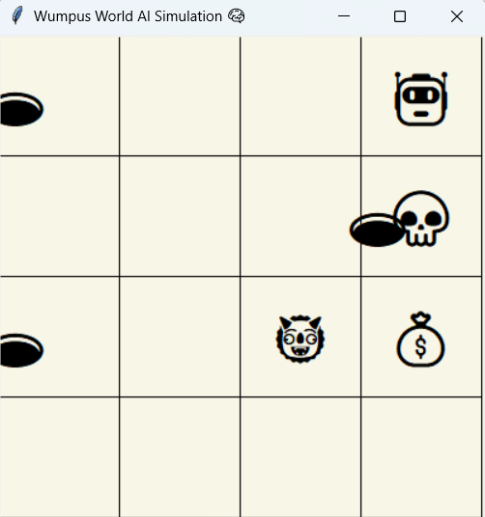
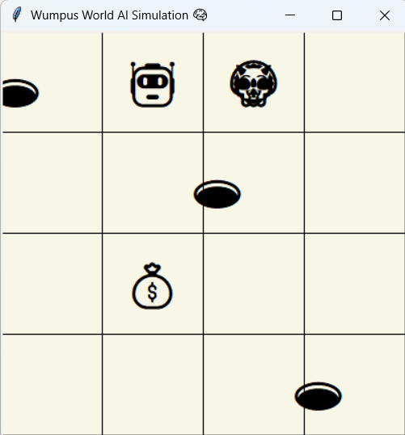
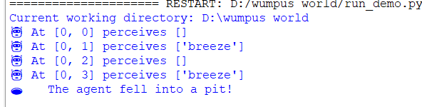
OUTPUT AND RESULTS

Slide 6
OUTPUT AND RESULTS
Explanation: The program simulates an intelligent Wumpus World agent operating in a grid-based environment. After each move, the agent perceives environmental cues such as Breeze, Stench, and Glitter. It then updates its Knowledge Base, applies logical inference rules, and determines which adjacent cells are safe or unsafe. Based on this reasoning, the agent decides whether to move, grab the gold, shoot the Wumpus, or exit the cave, demonstrating rational and goal-directed behavior.
Results:
Successfully developed a functional Wumpus world simulation using python and tkinter
Demonstrates knowledge based reasoning, logical inference and rational agent behavior in uncertain environment
Handles key conditions such as finding gold, falling into a pit, encountering the Wumpus, or exiting safely
Future Enhancements:
Add adaptive difficulty levels by increasing grid size or hazard probability
Integrate probabilistic reasoning or reinforcement learning for improved decision making
Include visual hints, step by step reasoning logs, performance statistics in the GUI
Explore Multi agent collaboration or dynamic Wumpus movement for advanced simulation.

Slide 7
REFERENCES
Russell, S. & Norvig, P. (2021). Artificial Intelligence: A Modern Approach (4th Edition). Pearson Education.
Nilsson, N. J. (1998). Artificial Intelligence: A New Synthesis. Morgan Kaufmann Publishers.
GeeksforGeeks (2020). Wumpus World in Artificial Intelligence. Retrieved from
https://www.geeksforgeeks.org/wumpus-world-in-artificial-intelligence/
Sebastian Lague (2018). Coding Adventure – Wumpus World & Logical Agent Simulation
[YouTube Channel: Sebastian Lague – AI and Logic Series].
Wikipedia Contributors. (2024). Wumpus World. Retrieved from
https://en.wikipedia.org/wiki/Wumpus_World

